Slide 1
Data Modelling
COMP .6108 Database Design and Development

Slide 2
Entity instance - person, place, object, event, concept (often corresponds to a row in a table)
Entity Type – collection of entities (often corresponds to a table)
Attribute - property or characteristic of an entity type (often corresponds to a field in a table)
Relationship instance – link between entities (corresponds to primary key-foreign key equivalencies in related tables)
Relationship type – category of relationship…link between entity types

Slide 3
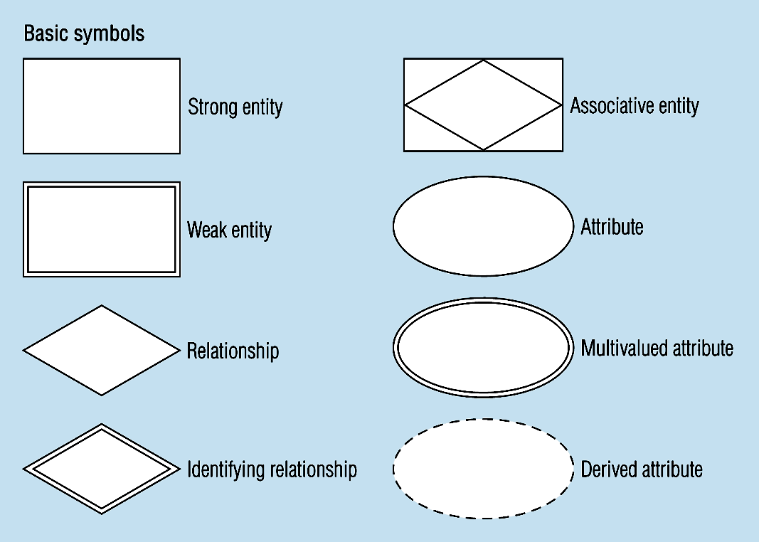
Figure 3-2 -- Basic E-R Notation
A special entity that is also a relationship
Entity symbols
Attribute symbols
Relationship symbols

Slide 4
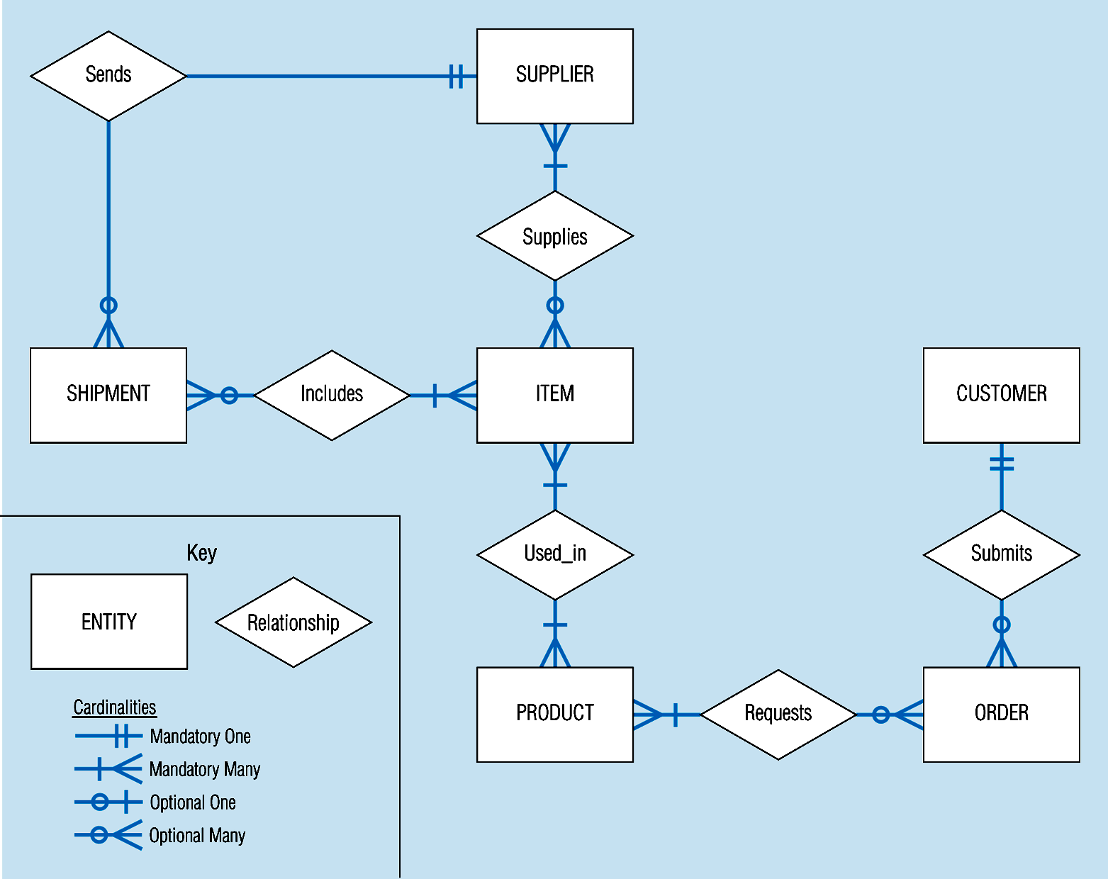
Sample E-R Diagram (figure 3-1)

Slide 5
What Should an Entity Be?
SHOULD BE:
An object that will have many instances in the database
An object that will be composed of multiple attributes
An object that we are trying to model
SHOULD NOT BE:
A user of the database system
An output of the database system (e.g. a report)

Slide 6
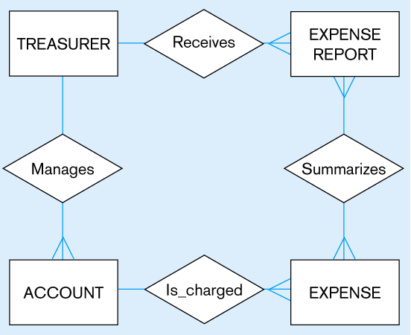
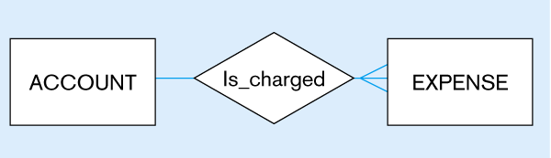
Figure 3-4
Inappropriate entities
System user
System output
Appropriate entities

Slide 7
Attributes
Attribute - property or characteristic of an entity type
Classifications of attributes:
Simple versus Composite Attribute
Single-Valued versus Multivalued Attribute
Stored versus Derived Attributes
Identifier Attributes

Slide 8
Identifiers (Keys)
Identifier (Key) - An attribute (or combination of attributes) that uniquely identifies individual instances of an entity type
Simple Key versus Composite Key
Candidate Key – an attribute that could be a key…satisfies the requirements for being a key

Slide 9
Characteristics of Identifiers
Will not change in value
Will not be null
No intelligent identifiers (e.g. containing locations or people that might change)
Substitute new, simple keys for long, composite keys

Slide 10
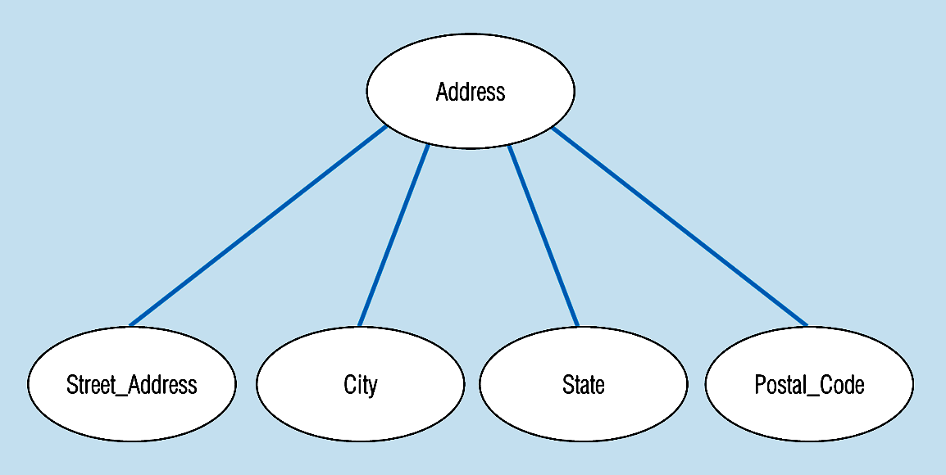
Figure 3-7 -- A composite attribute
An attribute broken into component parts

Slide 11
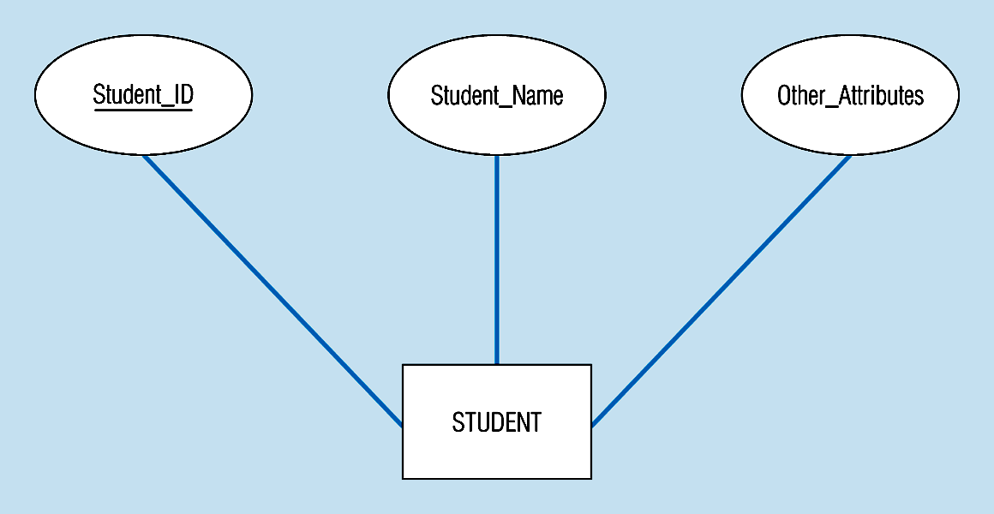
Figure 3-9a – Simple key attribute
The key is underlined

Slide 12
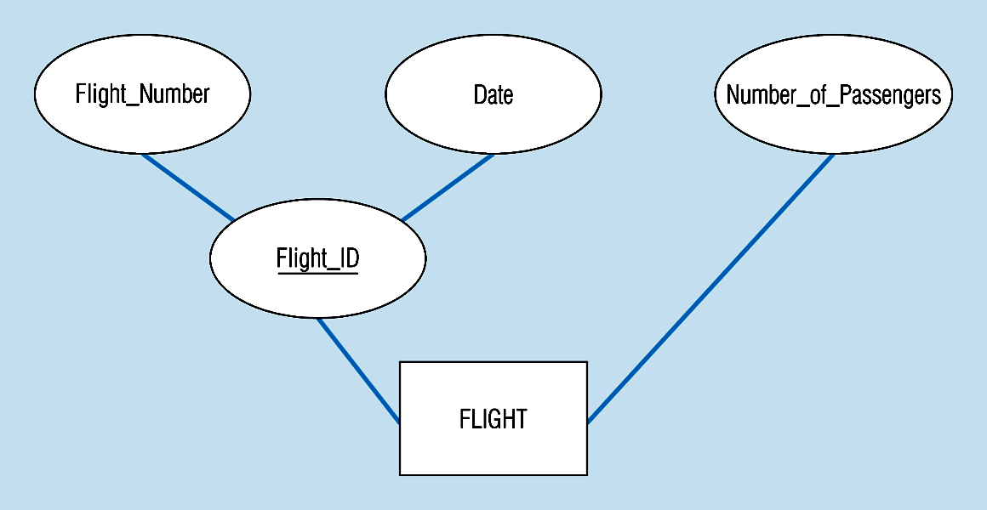
Figure 3-9b -- Composite key attribute
The key is composed
of two subparts

Slide 13
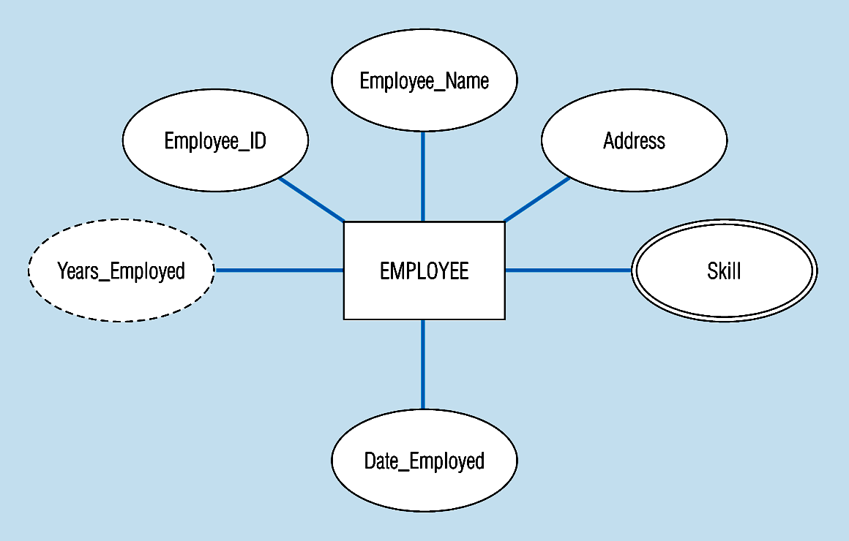
Figure 3-8 -- Entity with a multivalued attribute (Skill) and derived attribute (Years_Employed)
Multivalued:
an employee can have
more than one skill
Derived
from date employed and current date
Notes:
13

Slide 14
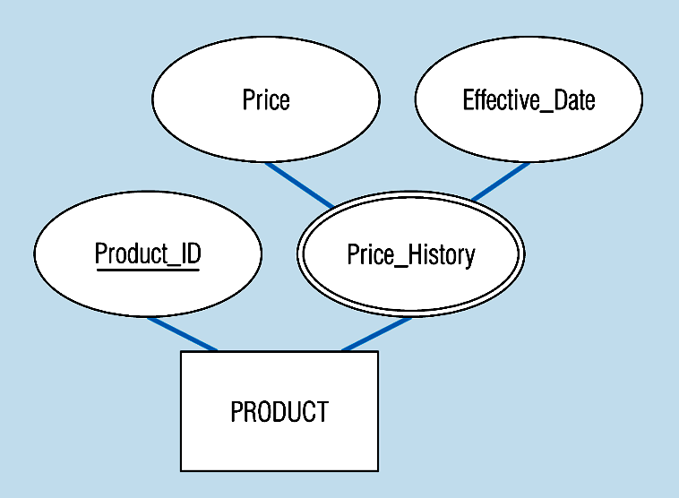
Figure 3-19 – an attribute that is both multivalued and composite
This is an example of time-stamping
Notes:
37

Slide 15
More on Relationships
Relationship Types vs. Relationship Instances
The relationship type is modeled as the diamond and lines between entity types…the instance is between specific entity instances
Relationships can have attributes
These describe features pertaining to the association between the entities in the relationship
Two entities can have more than one type of relationship between them (multiple relationships)
Associative Entity = combination of relationship and entity
More on this later

Slide 16
Degree of Relationships
Degree of a Relationship is the number of entity types that participate in it
Unary Relationship
Binary Relationship
Ternary Relationship
Notes:
16

Slide 17
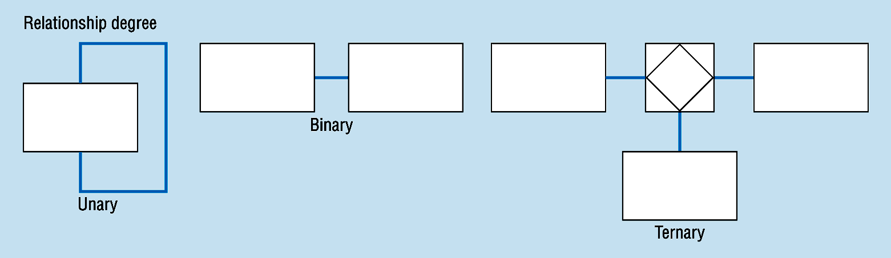
Degree of relationships – from figure 3-2
One entity related to another of the same entity type
Entities of two different types related to each other
Entities of three different types related to each other
Notes:
8

Slide 18
Cardinality of Relationships
One – to – One
Each entity in the relationship will have exactly one related entity
One – to – Many
An entity on one side of the relationship can have many related entities, but an entity on the other side will have a maximum of one related entity
Many – to – Many
Entities on both sides of the relationship can have many related entities on the other side

Slide 19
Cardinality Constraints
Cardinality Constraints - the number of instances of one entity that can or must be associated with each instance of another entity.
Minimum Cardinality
If zero, then optional
If one or more, then mandatory
Maximum Cardinality
The maximum number
Notes:
29

Slide 20
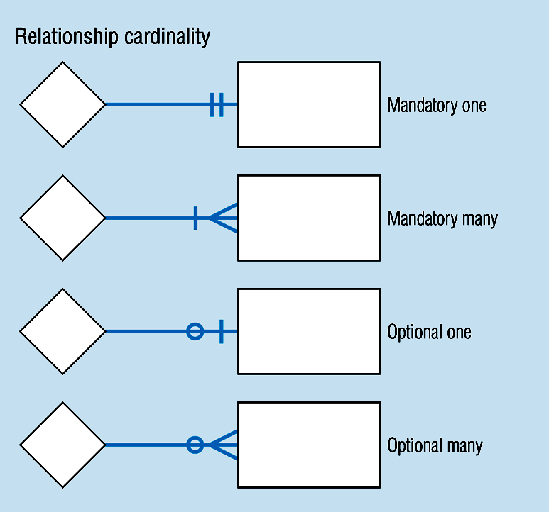
Cardinality – figure 3-2
Notes:
8

Slide 21
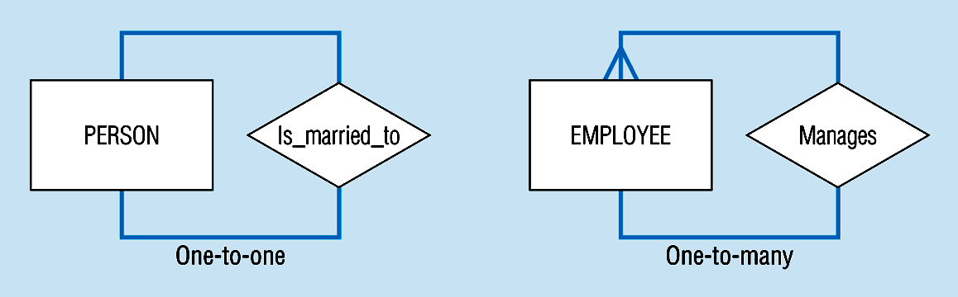
Unary relationships -- figure 3-12a
Notes:
22

Slide 22
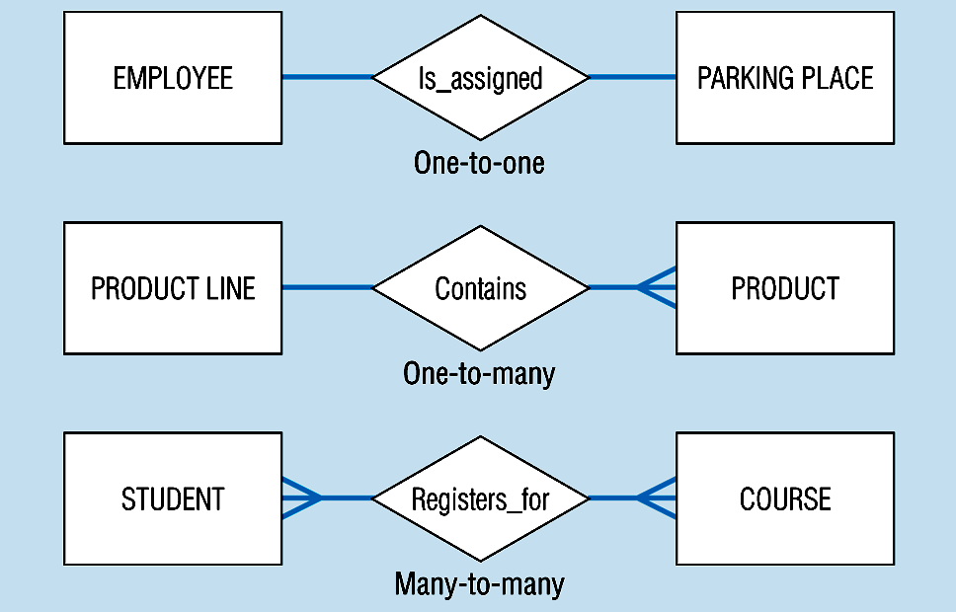
Binary relationships – figure 3-12b
Notes:
23

Slide 23
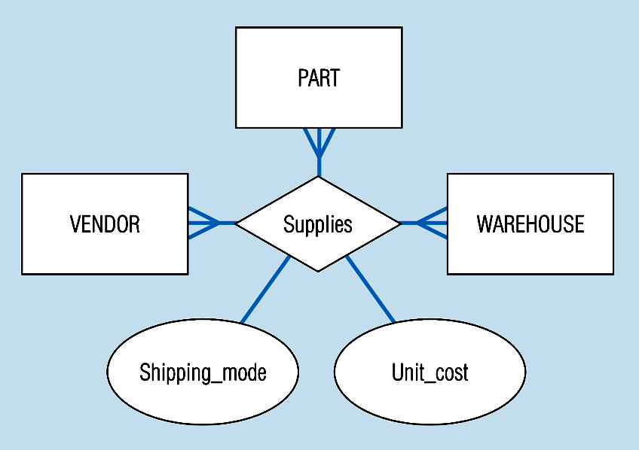
Ternary relationships –figure 3-12c
Note: a relationship can have attributes of its own
Notes:
24

Slide 24
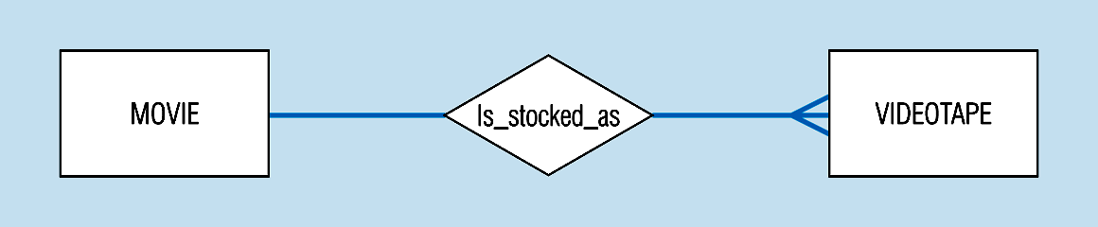
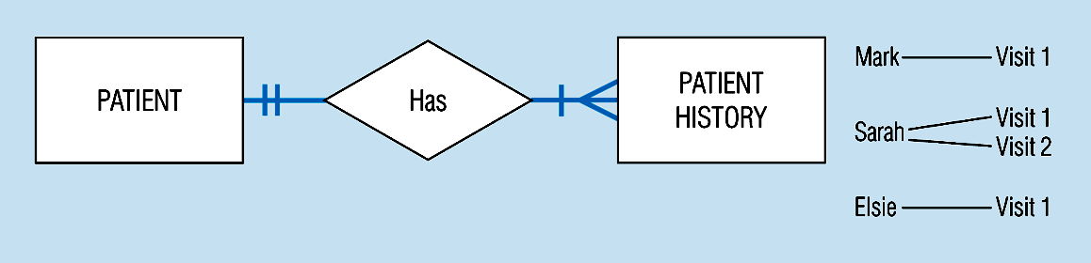
Basic relationship with only maximum cardinalities showing –
figure 3-16a
Mandatory minimum cardinalities – figure 3-17a
Notes:
1

Slide 25
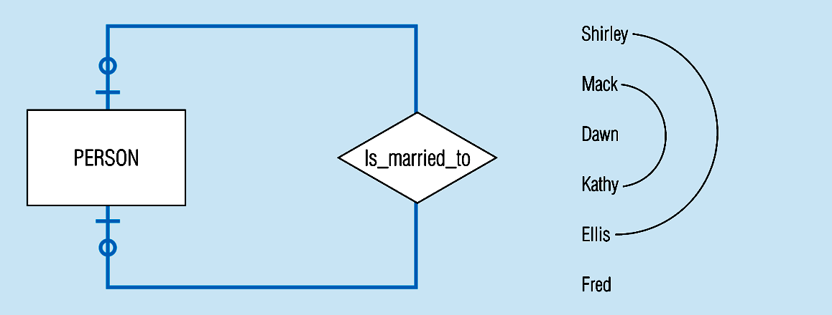
Figure 3-17c
Optional cardinalities with unary degree, one-to-one relationship
Notes:
34

Slide 26
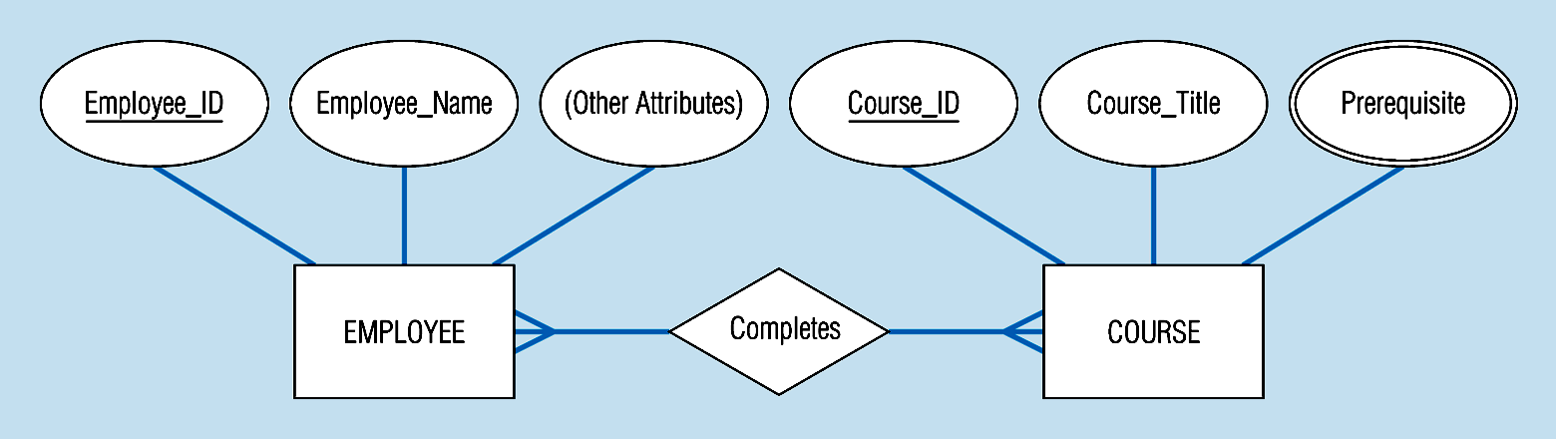
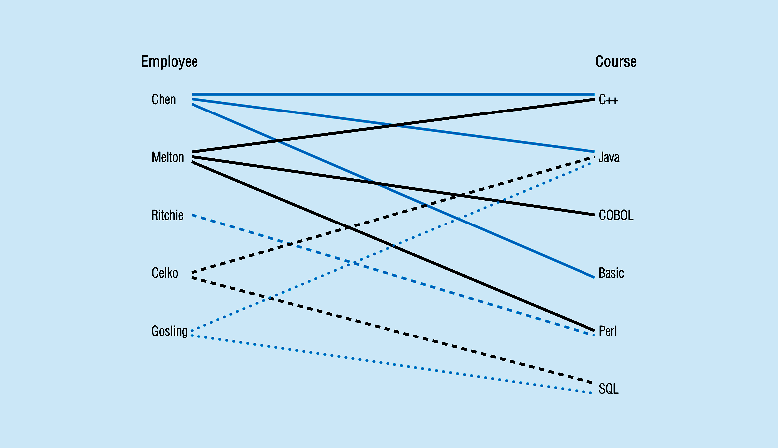
Figure 3-10a Relationship type
3-10b Entity and Relationship instances
Notes:
17

Slide 27
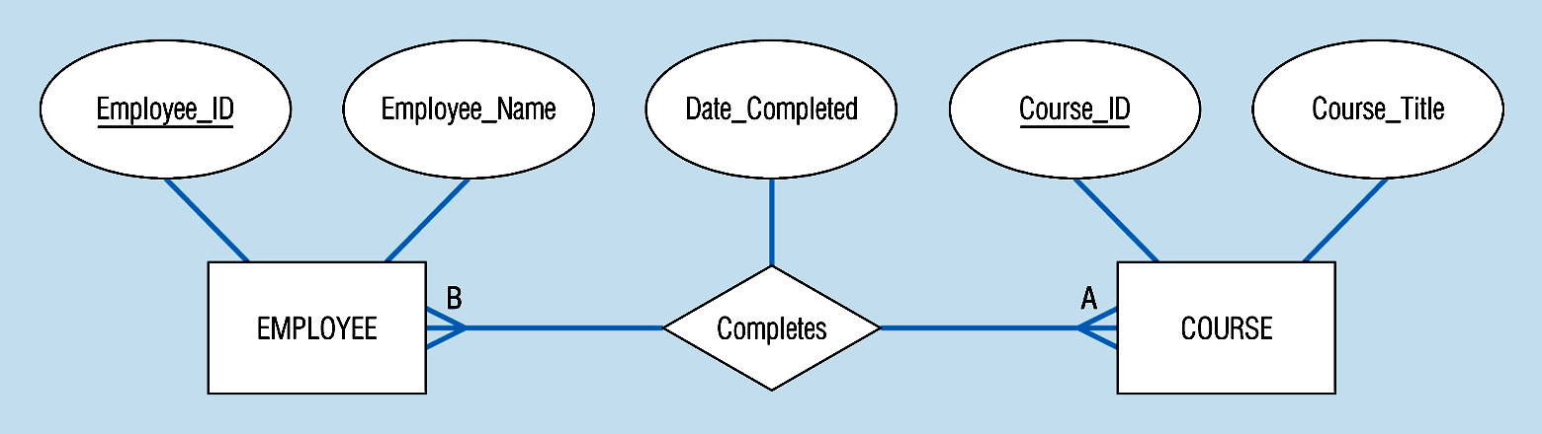
Figure 3-11a A binary relationship with an attribute
Here, the date completed attribute pertains specifically to the employee’s completion of a course…it is an attribute of the relationship
Notes:
20

Slide 28
Figure 3-12c -- A ternary relationship with attributes
Notes:
24

Slide 29
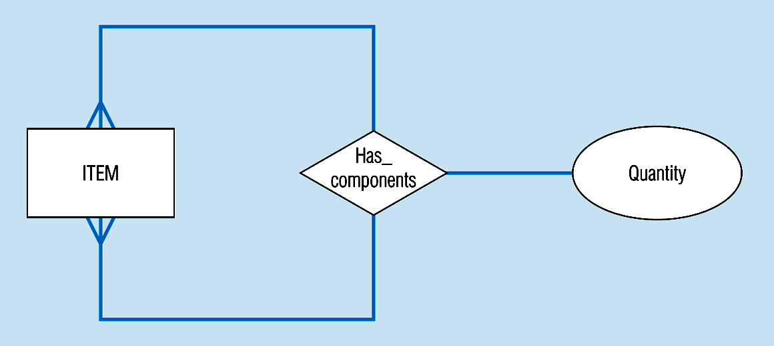
Figure 3-13a A unary relationship with an attribute. This has a many-to-many relationship
Representing a bill-of -materials structure
Notes:
25

Slide 30
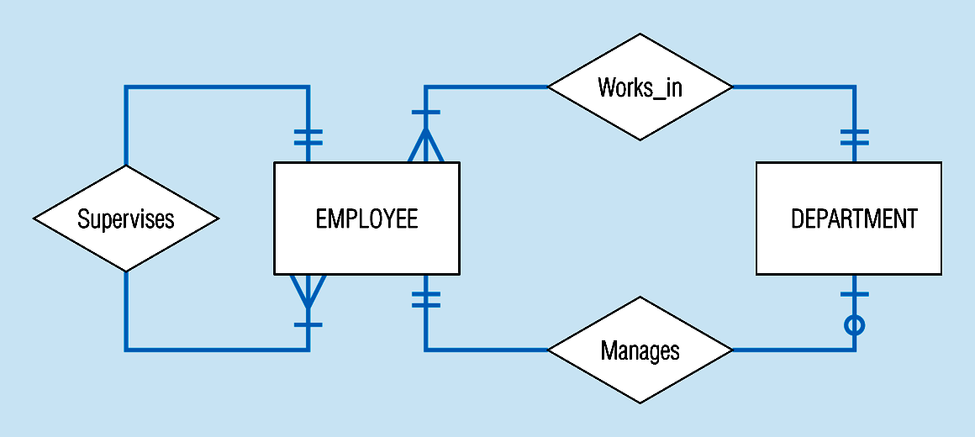
Examples of multiple relationships – entities can be related to one another in more than one way
Figure 3-21a Employees and departments
Notes:
40

Slide 31
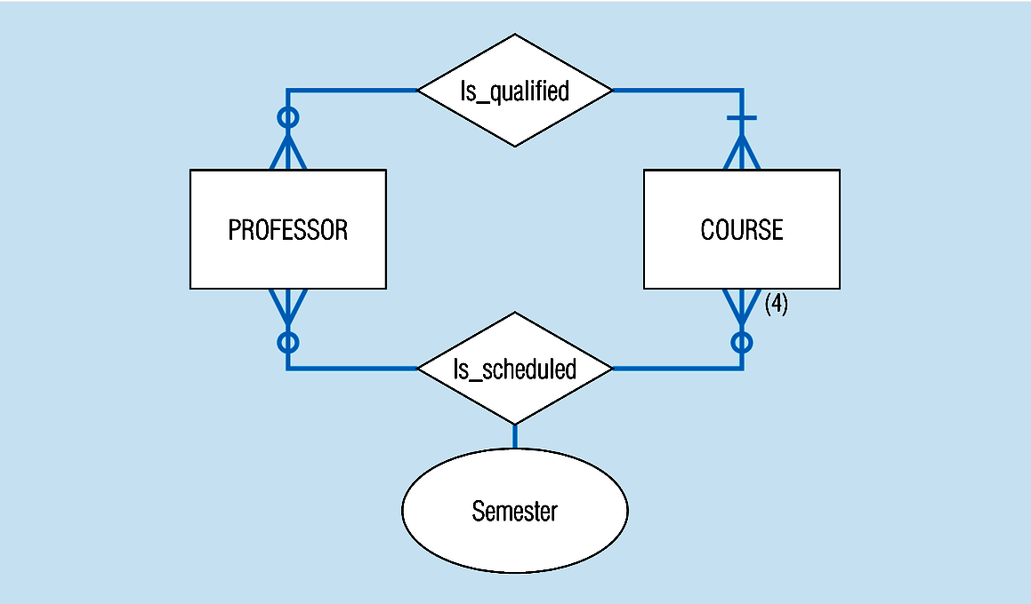
Figure 3-21b -- Professors and courses (fixed upon constraint)
Here,max cardinality constraint is 4
Notes:
41

Slide 32
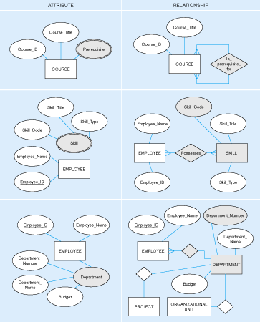
Figure 3-15: Multivalued attribute vs. relationship. Alternative approaches

Slide 33
Strong vs. Weak Entities, and Identifying Relationships
Strong entities
exist independently of other types of entities
has its own unique identifier
represented with single-line rectangle
Weak entity
dependent on a strong entity…cannot exist on its own
Does not have a unique identifier
represented with double-line rectangle
Identifying relationship
links strong entities to weak entities
represented with double line diamond

Slide 34
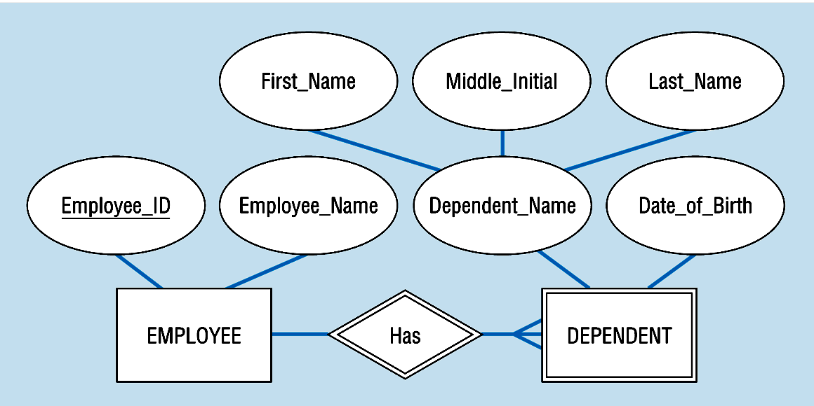
Figure 3-5: Strong and weak entities
Strong entity
Identifying relationship
Weak entity

Slide 35
Associative Entities
It’s an entity – it has attributes
AND it’s a relationship – it links entities together
When should a relationship with attributes instead be an associative entity?
All relationships for the associative entity should be many
The associative entity could have meaning independent of the other entities
The associative entity preferably has a unique identifier, and should also have other attributes
The associative may be participating in other relationships other than the entities of the associated relationship
Ternary relationships should be converted to associative entities (p102)

Slide 36
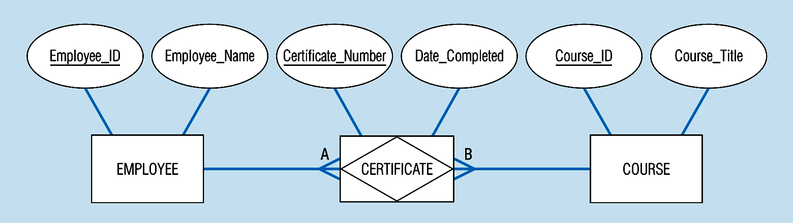
Figure 3-11b: An associative entity (CERTIFICATE)
Associative entity involves a rectangle with a diamond inside.
Note that the many-to-many cardinality symbols face toward the associative entity and not toward the other entities
Notes:
21

Slide 37
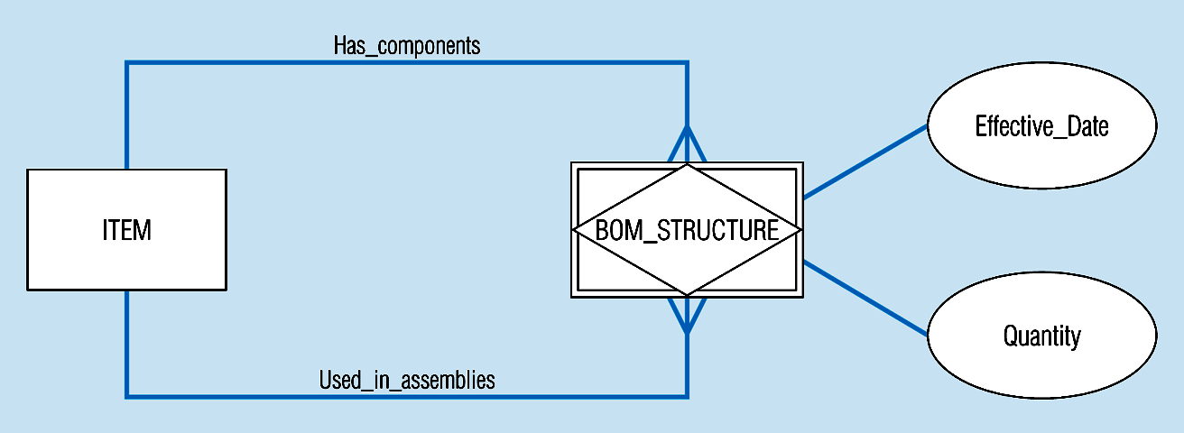
Figure 3-13c -- an associative entity – bill of materials structure
This could just be a relationship with attributes…it’s a judgment call
Notes:
27

Slide 38
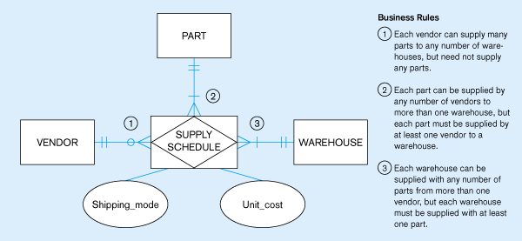
Figure 3.18 -- Ternary relationship as an associative entity
Notes:
36

Slide 39
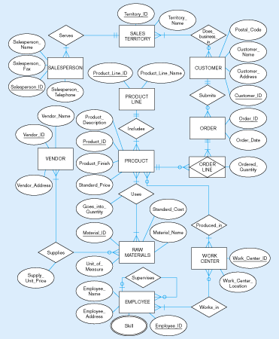
Figure 3-22
E-R diagram for Pine Valley Furniture

